Slide 1
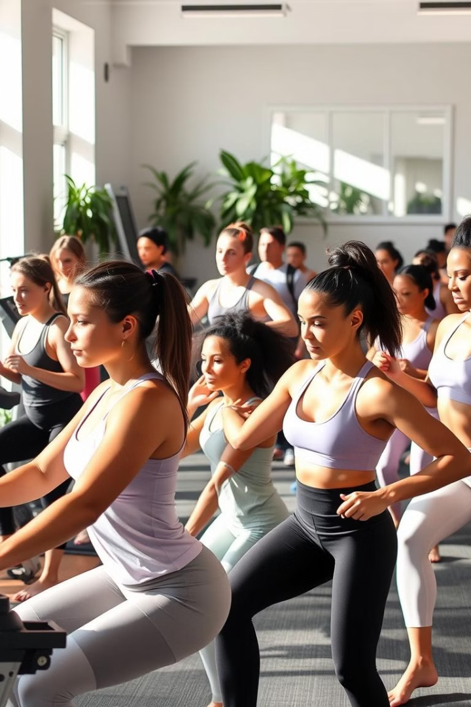

Customized Workout Planner: Tailored Fitness for You
Unlock your fitness potential with our customized workout planner. Experience tailored fitness designed just for you. Optimize results and achieve your unique goals.

Slide 2
The Problem: Generic Workout Plans Don't Work
Lack of Personalization
Increased Risk of Injury
Reduced Motivation
Generic plans don't account for individual needs. They often lead to poor results and frustration.
Ignoring personal limitations can increase injury risk. Proper form can suffer when you try to follow a generic plan.
When you don't see progress, motivation fades fast. A tailored approach makes it easier to keep going.

Slide 3

Our Solution: Personalized Fitness Through AI
1
AI-Driven Customization
2
Data-Driven Insights
Our planner uses AI to create personalized plans. It optimizes exercises based on your specific data.
Gain insights from your workout data to improve your routine. Make informed decisions for better outcomes.
3
Continuous Adaptation
The AI adapts your plan as you progress. This ensures continuous improvement and results.

Slide 4
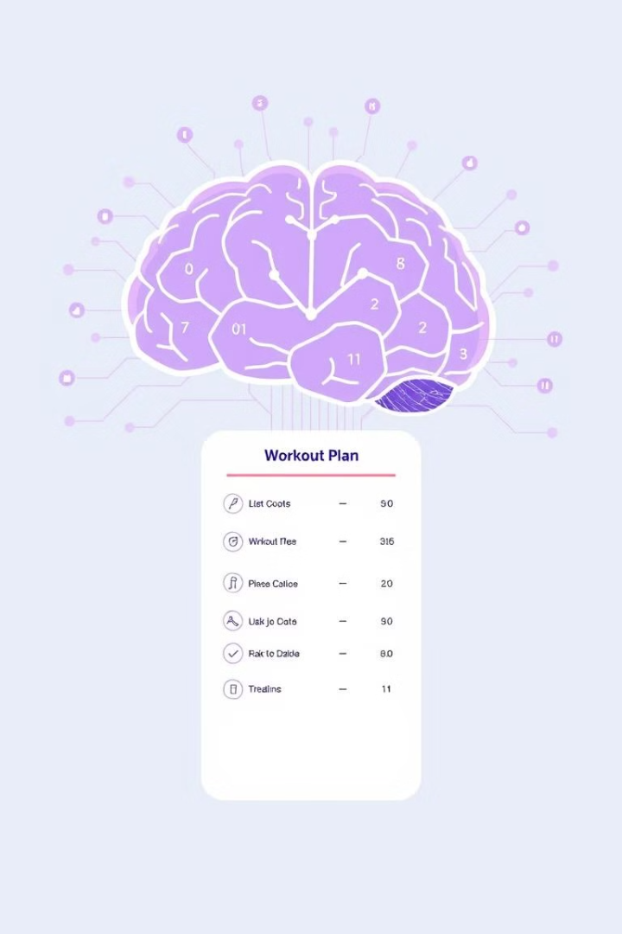



How It Works: Input, Analysis, and Plan Generation
User Input
Enter your fitness goals and current condition.
AI Analysis
The AI analyzes your input, finding optimal patterns.
Plan Generation
A tailored workout plan is generated for you.

Slide 5
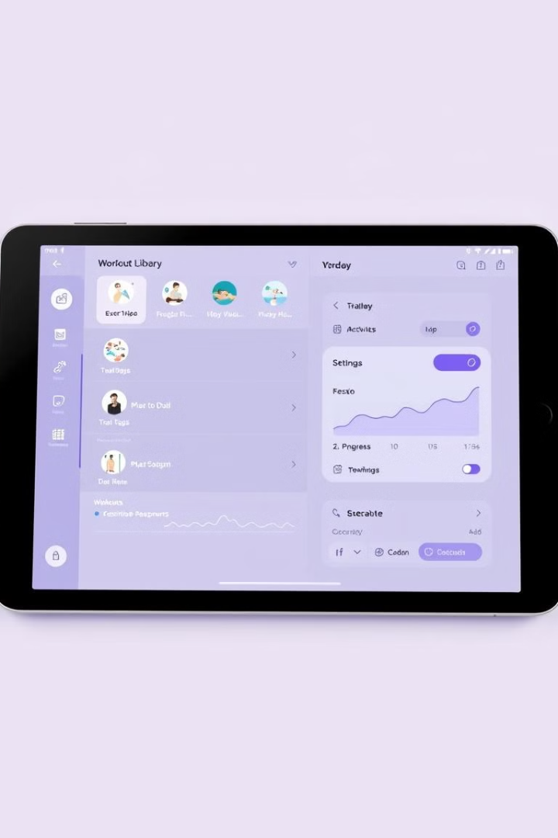



Key Features: Exercise Library, Progress Tracking, and Adaptability
Exercise Library
Progress Tracking
Adaptability
The plan adapts to your needs and goals.
Access a vast library of exercises with detailed instructions.
Monitor your progress and see your improvements over time.

Slide 6
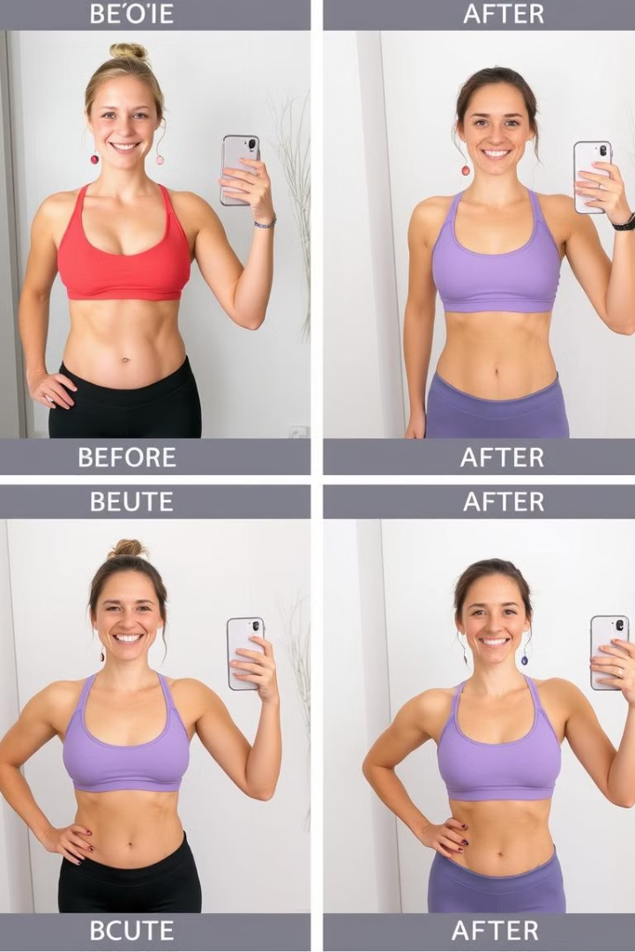
Real-World Results: Success Stories and Case Studies
Sarah's Transformation
John's Injury Recovery
Sarah lost 20 pounds and gained muscle in 3 months using our plan.
John recovered from a knee injury with a personalized rehab plan.
Emily's Marathon Prep
Emily improved her marathon time by 30 minutes with our guidance.

Slide 7

Demo: See the Planner in Action
Account Setup
1
Create your account and enter basic information.
2
Goal Definition
Set your fitness goals and preferences.
Plan Generation
3
The AI generates a custom workout plan for you.
4
Workout Tracking
Log your workouts and track your progress.

Slide 8



Benefits: Maximize Results, Minimize Risk, and Stay Motivated
Results
1
Achieve your goals faster
Safety
2
Reduce injury risk.
Motivation
3
Stay engaged and inspired.
Personalized plans help you get the most out of every session. Reduce the risk of injury with our AI-driven program. Stay on track and motivated with customized fitness.

Slide 9
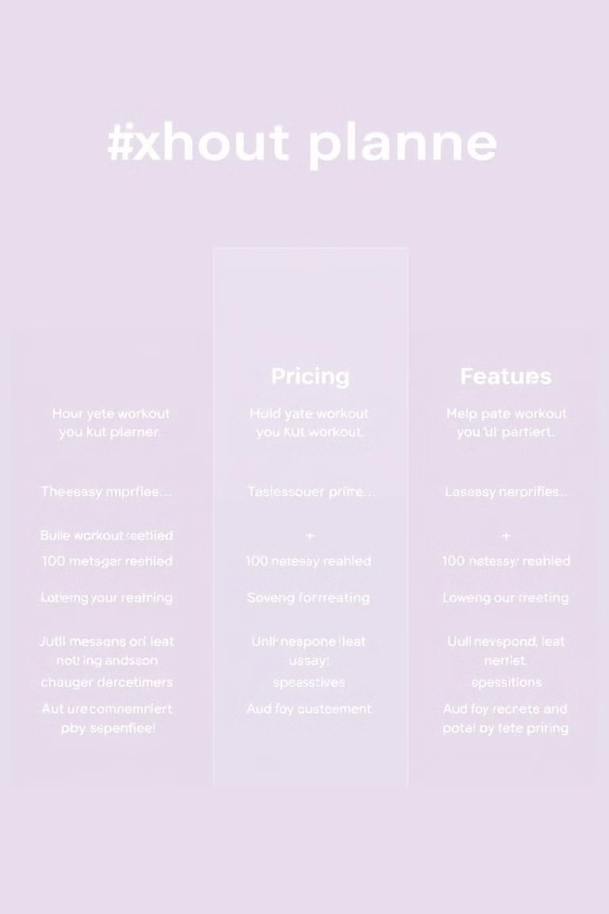
Pricing and Packages: Find the Right Fit for Your Needs
Basic
Standard
Premium
$9.99/month
$19.99/month
$29.99/month
Limited features
Full access
Personal coach

Slide 10

Q&A and Next Steps: Start Your Fitness Journey Today
Ready to transform your fitness journey? Start with our customized workout planner. Contact us for any questions or support.
Next steps: Sign up for a free trial and explore the features. Personalize your fitness journey now.

